Slide 1

University of Prishtina “HASAN PRISHTINA”
Faculty of Electrical and Computer Engineering
DEPARTMENT : Computer Engineering
Impact of Covid-19 in Economy of Kosovo
Professor : Lule Ahmedi Students/Nr.ID : Agnesa Selimi/180714100043
Diellza Aliu/180714100105
May 2021, Prishtina

Slide 2
Content
Introduction………………………………………………………………………………………………………………………………………………………………………3
Purpose of project………..………………………………………………………………………………………...………………………………………………………..4
Description of dataset…………………………………………………………………………………………………………………………………………………….5
Used Algorithm ……………………………………………………………………………………………………………………………………………………………….6
Problem solution…………………………………………………………………………………………………………………………………...…..……………………..7
Implementation of algorithm………………………………………………………………………………………………………………………………………..8
Code and Visual Graphs ………………………………………………………………………………………………… ……………………………………….….13
Accuarcy of datas…………………………………………………………………………………………………………………………………………………….……..27
Conclusion……………………………………………………………………………………………………………………………………………………………………….26
References………………………………………………………………………………………………………………………………….....................................................27

Slide 3
The impact of COVID-19 on the economy of Kosovo
In a study conducted by Business Association in Kosova, when they were asked if Covid 19 has affected their ability to survive:
59.4% of enterprises have expressed concerns about their ability to survive the crisis
As 99% of businesses in Kosovo are classified as NVM,these enterprises perceive the highest risk for their survival
The most affected sectors by this drastic decline in products are hotels, tourism and gastronomy, some manufacturing sectors, wholesale trade, a portion of retail trade such as the real estate market
It is predicted that about 10 thousand companies have gone brankrupt and about 50 thousand workers have lost their jobs
According to the World Bank, the 2020 contraction is expended to reach 8.8% and the recovery will be longer. Growth is predicted to return to 3.7% in 2021 and then accelerate to 4.9% in 2022.

Slide 4

Purpose Of The Project
In this project, the analysis will be provided to find which sectors are the most affected in economy due to the pandemic and also how accurate are the data information. Having into consideration that the impact of the Covid 19 has reached almost every country in the world not just Kosovo, we have seen it reasonable to gather some datas where we have analyzed which one of the sectors was the most affected, the one that was not affected at all and which one has been profitable during pandemic period.
.

Slide 5
Description of Dataset
Along the project we will read the dataset we chose which contains 1026 records and 11 columns.
The dataset is combined, some data are taken from the site of https://arbk.rks-gov.net/ and some others from https://gjejbiznese.com/
Here are 11 metadata from the dataset:
CEO Name = Name of Bussines CEO
Company Name = Name of the Bussines
Number of business = Unique nr. ID for the company
Sector= Name of the sectors impacted by Covid-19
Type of business= Individual/limited liability company/joint stock company
Country=Cities of Kosovo
Population = Numer of population for every city
Date = Date of data registration
Employers Number = Employers number for each company
Total GDP=Gross Domestic product per Bussines
Sector GDP=Gross domestic product per sector

Slide 6
Data Mining Algorithms
Used Algorithm In This Project
Classification
Decision Tree
K-Nearest Neighbours
Regression
Support Vector Machine(SVM)
Simple Linear Regression
Clustering
K-Means Clustering
Mean-Shift Clustering
Dimensionality reduction
Genetic Algorithms
Decision Tree(CART)
The CART algorithm is structured as a sequence of questions, the answers to which determine what the next question,if any should be.The result of these question is a tree like structure where the ends are terminal nodes at which point there are no more questions. Just as in our case where the questions will determine which sector is most affected from COVID-19 pandemy.

Slide 7
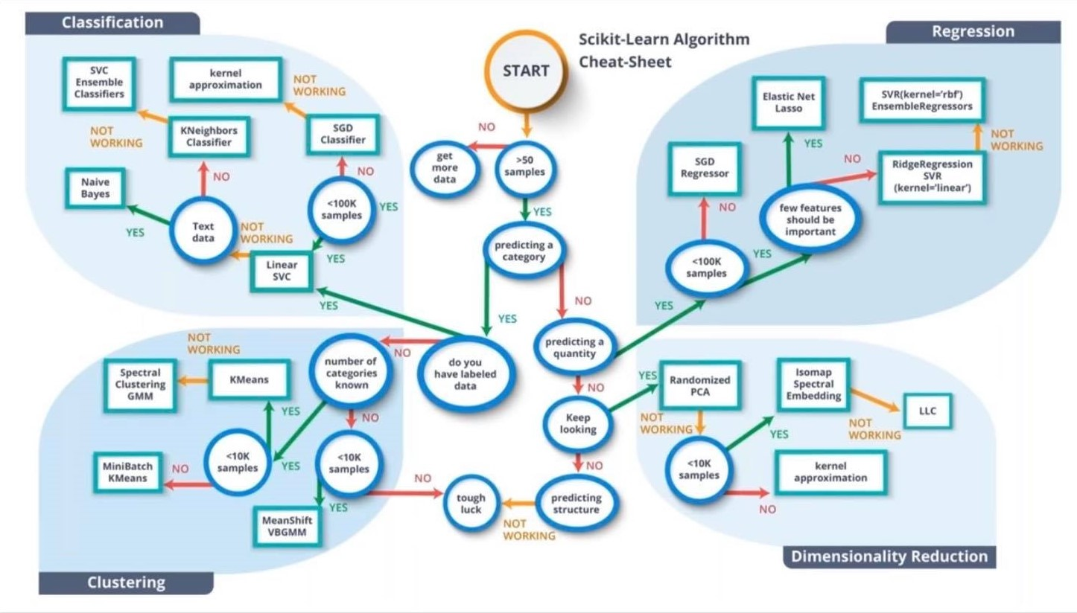

Slide 8
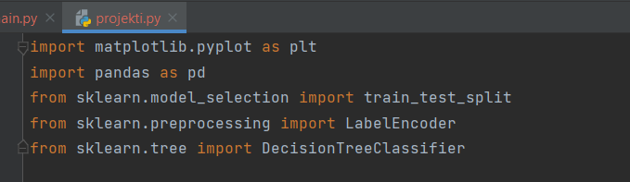
Problem solution
Libraries that should be imported:

Slide 9

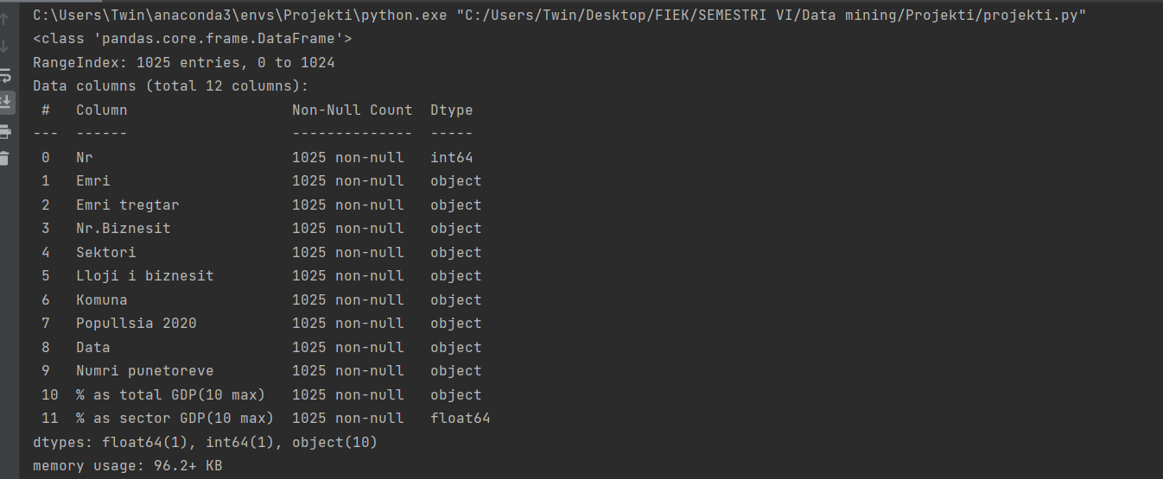
Reading dataset and printing it out with the informations

Slide 10
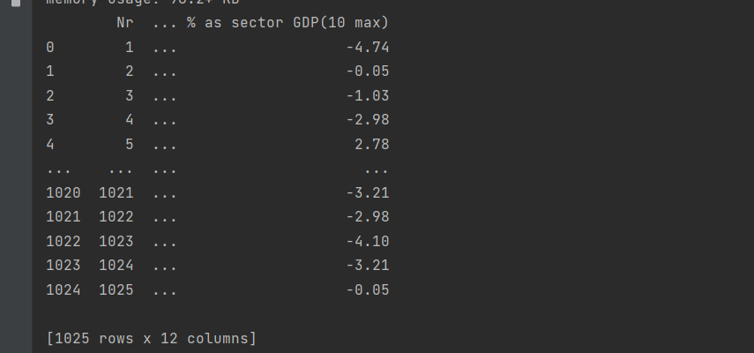
Information of the dataset rows and columns

Slide 11

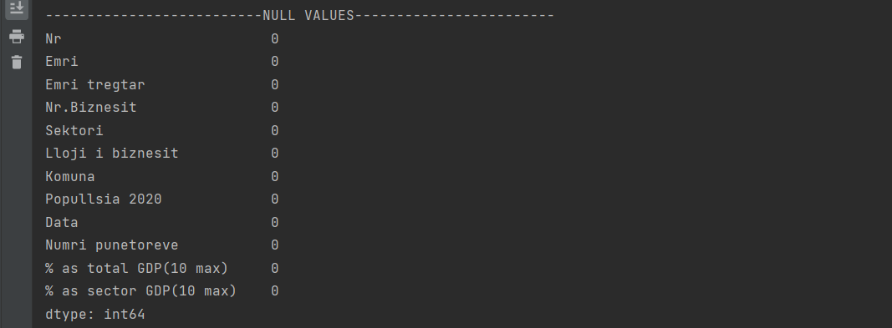
Checking if there is any null values
As we show none of datas have null values

Slide 12

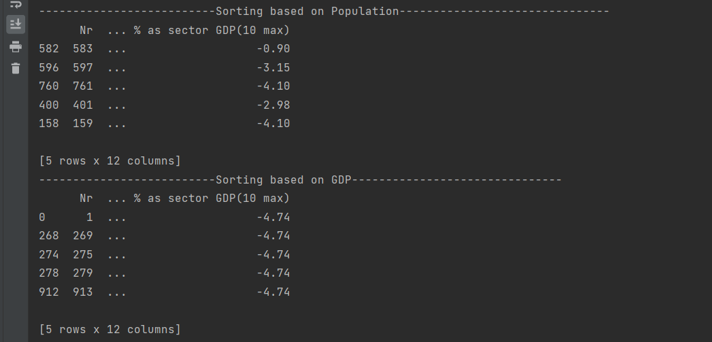
Sorting records based on column Popullsia and Gross domestic Product(GDP)
The city with the the biggest population is Prishtina - 208,230
Residents
(Go check the dataset)

Slide 13

Data analysis for Sector GDP per Country
Next page is the execution for this program

Slide 14
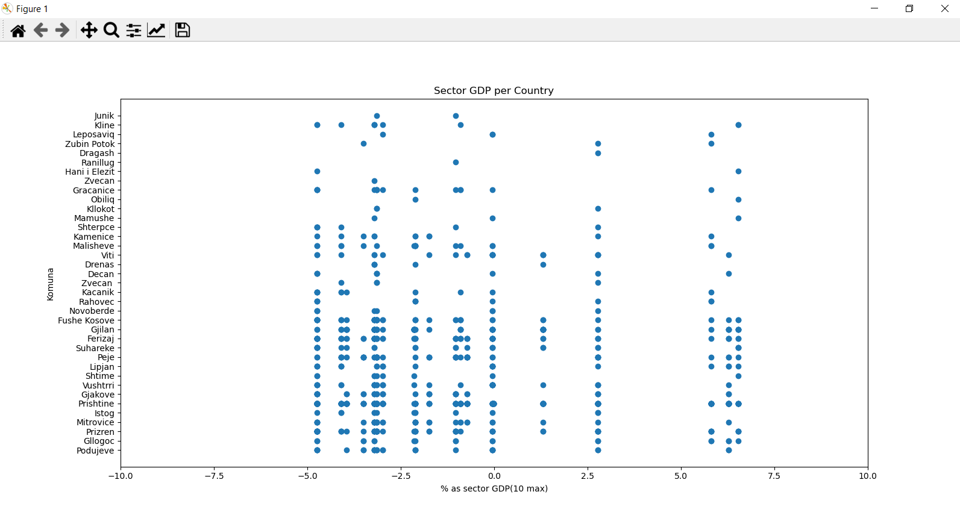
Graph of sector GDP per country
To the graph below we have presented cities of Kosova that were affected by Covid-19 for each sectors.

Slide 15
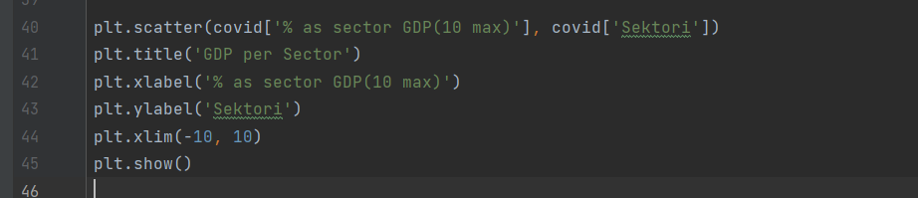
Data analysis for GDP per Sector
Next page is the execution for this program

Slide 16
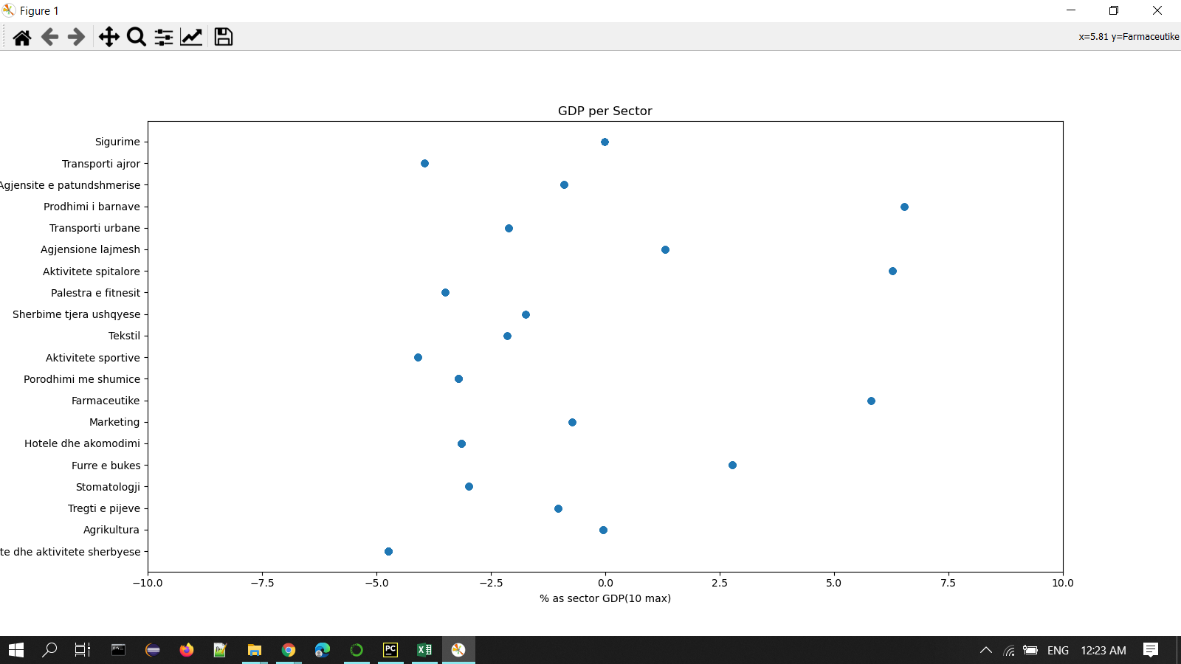
Graph of GDP per Sector
As we see the most affected sector were restaurants and service activity with a percentage somewhere around -4.7%, the one that was not affected at all is agriculture (0%) and the sectors that were profitable during pandemic were drug production and hospital activities with a percentage around 6.7%

Slide 17
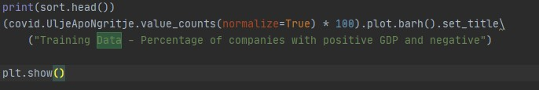
Ups or Downs values during the pandemic
Next page is the execution for this program

Slide 18
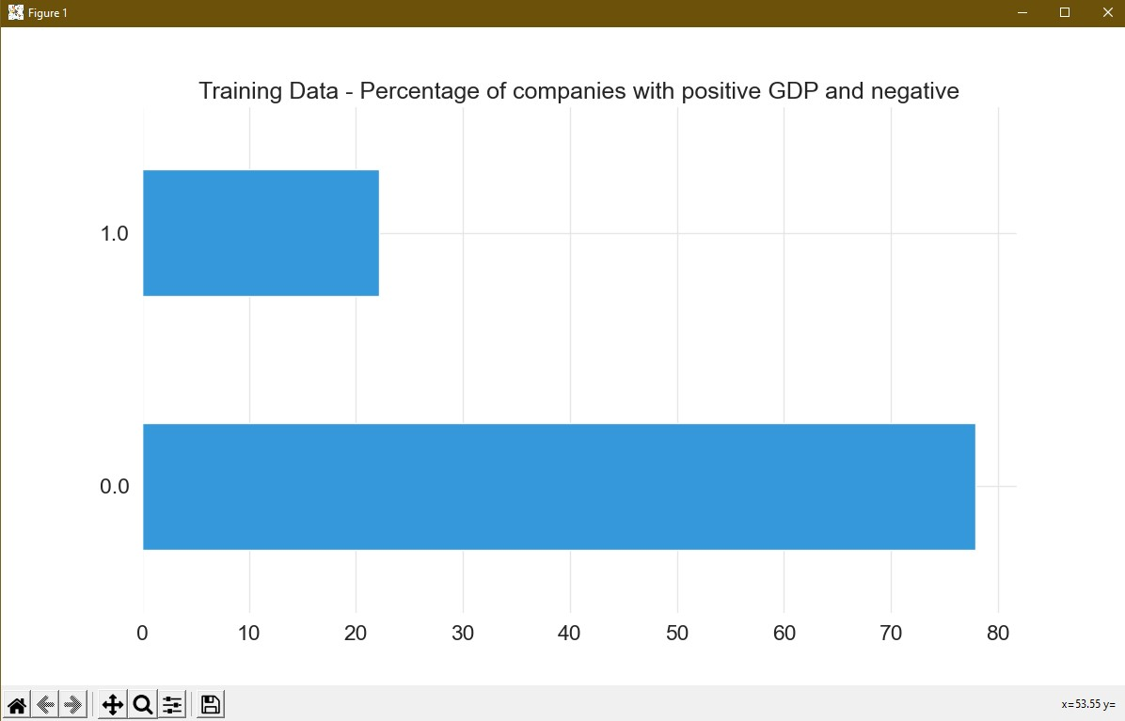

Slide 19
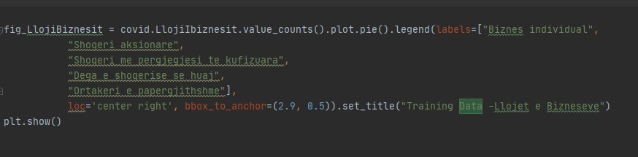
Type of businesses
Next page is the execution for this program

Slide 20
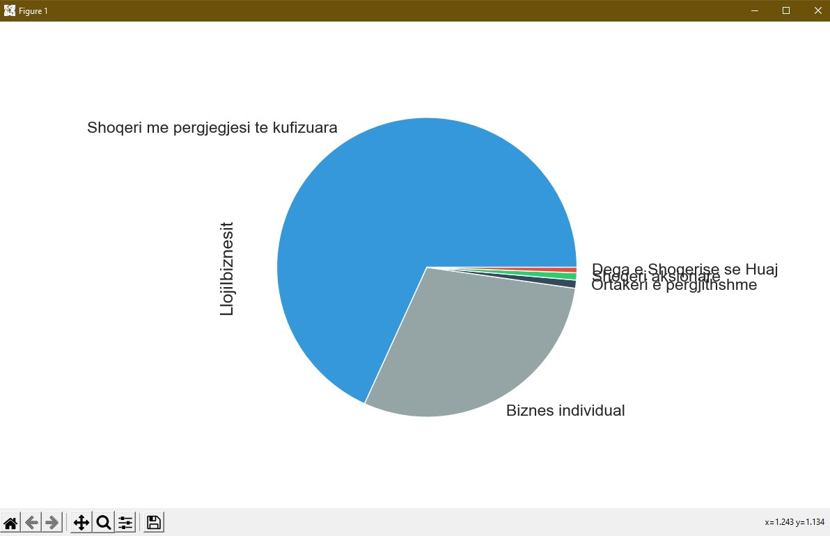
As we show most of businesses in Kosovo are limited liability company ,less are individual businesses and others general partnership, foreign business branch and joint stock business.

Slide 21
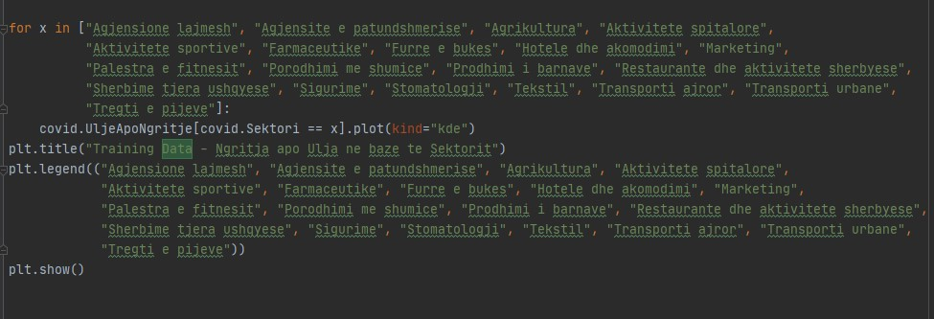
Increase and decrease of sectors during pandemic
Next page is the execution for this program

Slide 22
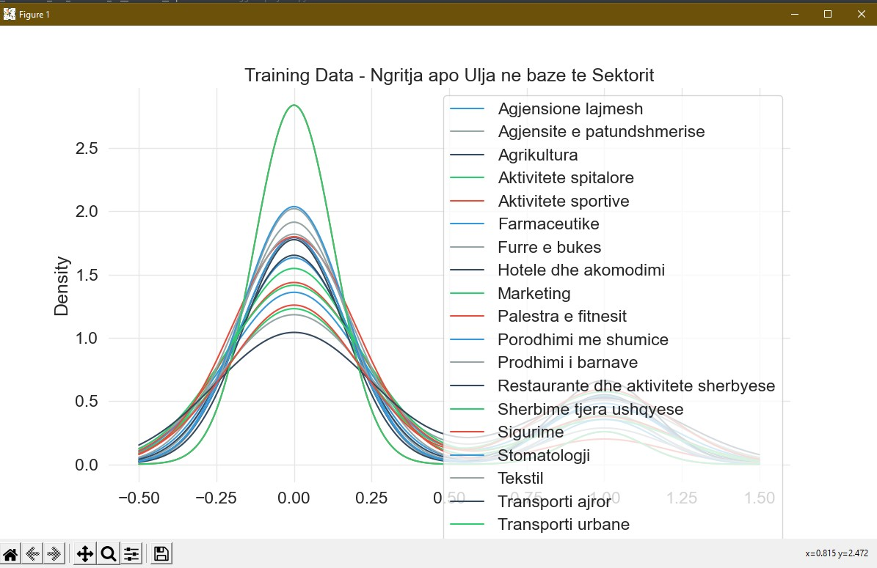

Slide 23
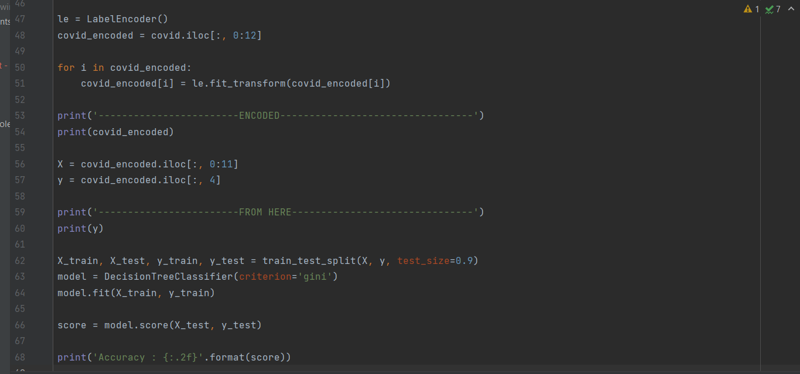
Implemented CART Algorithm

Slide 24
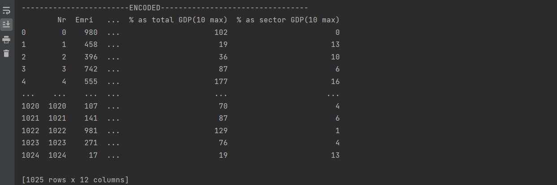
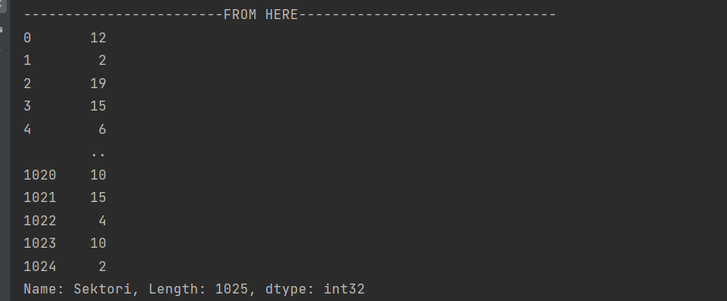

Slide 25

Accuracy of data based on 30% of tested data to predict the rest of it.

Slide 26
Conclusion
During this project we have analyzed the accuracy of data from the dataset that explains the impact of COVID-19 in economic downturn in all cities of Kosovo.
We came up with the conclusion that the most affected sectors are gastronomy,tourism, hotels air transport ,some manufacturing sectors ect.
The medical sector has been the only profitable sector of all sectors. This sector includes pharmaceutical manifacturing, drug production, hospital activities etc.
Some of the sectors have not changed, nor have been profitable or at loss, for example market stores, news agencies etc.

Slide 27
References
https://arbk.rks-gov.net/
https://www.datasciencecentral.com/profiles/blogs/introduction-to-classification-regression-trees-cart
https://www.youtube.com/watch?v=s5Plqr0Y7D8
https://sq.wikipedia.org/wiki/Lista_e_vendbanimeve_n%C3%AB_Kosov%C3%AB?fbclid=IwAR0f6SaXnuDEsdR6kVhAynaEhM9xid-Vu-3ZC3Sq77Q97UYmIqSVLVFO7EE
Statistics in page three are taken along a lecture that we followed from Office for Research and Sponspored Projects - University of Prishtina "Hasan Prishtina"

